Slide 1
Connection Control Studying sty - Device Driver -
ELEC462003 System Programming

Slide 2





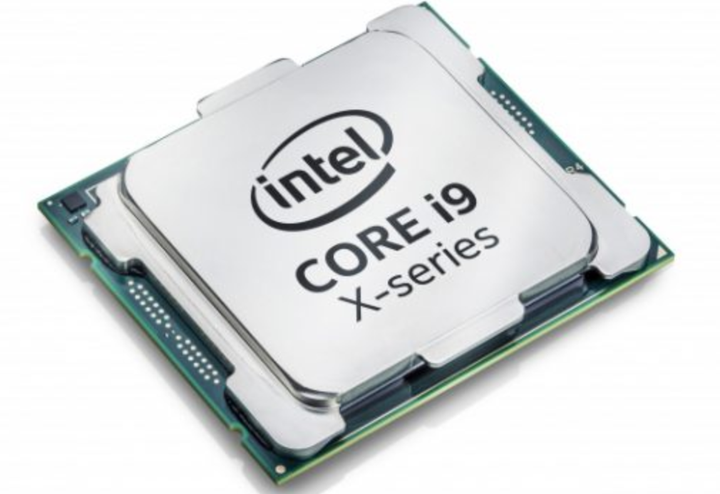
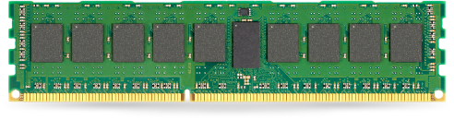
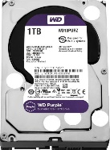

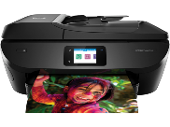
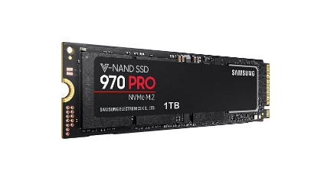
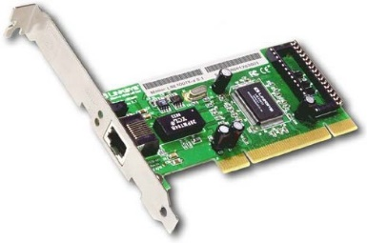
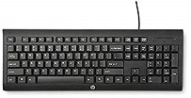
What we will learn ..
Application
(Process)
Application
(Process)
Application
(Process)
Application
(Process)
Application
(Process)
User space
System Call
System Call Interface
Kernel (OS) space
Process
management
memory
management
File systems
I/O
Management
Network
Component
Functionality
Multitasking
Virtual Memory
Files, directories
Device access
Network functionality
Software
Support
Scheduler
Memory
manager
Naming, Access,
Buffering
Character
device driver
Network
Protocol
Hardware
Support
Architecture
-specific code
Block
device driver
Network
Device driver
Hardware Interface
Hardware

Slide 3
Objectives
Ideas and Skills
Similarities between files and devices
Differences between files and devices
Attributes of connections
Controlling device drivers
System Calls and Functions
fcntl, ioctl
tcsetattr, tcgetattr
Commands
stty
write

Slide 4
Contents
5.2 Devices Are Just Like Files
5.3 Devices Are Not Like files
5.4 Attributes of Disk Connections
5.5 Attributes of Terminal Connections
5.6 Programming Other Devices: ioctl

Slide 5
Devices Are Just Like Files
To Unix/Linux, sound cards, terminals, mice, and disk files are the same sort of device object.
In a Unix/Linux system, every device is treated as a file.
Every device has ..
a filename
an inode #
an owner
a set of permission bits
and a last-modified time
Everything working with files automatically applies to all device objects.
We can control devices with system call
open, read, write, lseek, close, stat

Slide 6
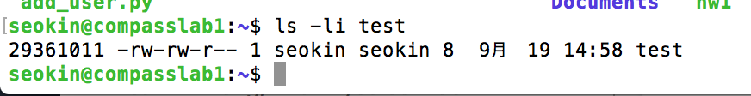
Devices Have Filenames
Files that represent devices are in the /dev directory
Disk file (regular file)
Device file
inode
mode
owner
group
Last_modified time
filename
link
owner
Last_modified time
filename
inode
link
group
minor # : Device
mode
major # : Device Driver
* Directory(d), Symbolic Link(l), Character Device(c), Block Device(b)
Notes:
hwinfo –disk
lsblk -d

Slide 7
Devices and System Calls
Devices support all file-related system calls: open, read, write, lseek, close, stat
Ex) code to read from a disk
→ Directly read data stored in the hard disk
Some devices do not support all file operations
/dev/input/mice file does not support the write()
Terminals support read() and write(), but they do not support lseek().
int fd = open("/dev/sda", O_RDONLY);
lseek(fd, 0, SEEK_SET);
read(fd, buffer, 512);
$ sudo cat /dev/sda1 | hexdump

Slide 8
Terminals Are Just Like Files (I)
A terminal is anything that behaves like the classic keyboard and display unit
A telnet or ssh window logged in over the Internet behaves like a terminal.
Command tty prints the file name of your terminal
We can use any file commands and operations with that file: cp, >, mv, ln, rm, cat, ls
*tty: teletypewriter
Notes:
/etc/motd is a file on Unix-like systems that contains a "message of the day", used to send a common message to all users in a more efficient manner
/etc/issue is a text file which contains a message or system identification to be printed before the login prompt
including
an actual 1970s printing terminal,
a keyboard and CRT attached to a serial port, or
a PC with a modem and terminal emulation software dialed up over a phone line.

Slide 9
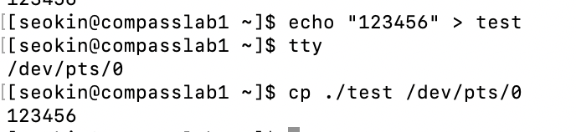
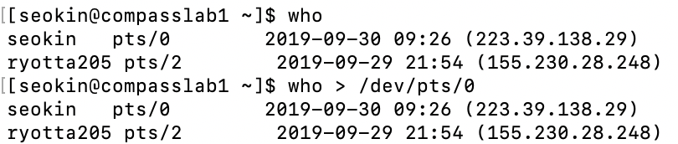
Terminals Are Just Like Files (II)
Notes:
/etc/motd is a file on Unix-like systems that contains a "message of the day", used to send a common message to all users in a more efficient manner
/etc/issue is a text file which contains a message or system identification to be printed before the login prompt

Slide 10
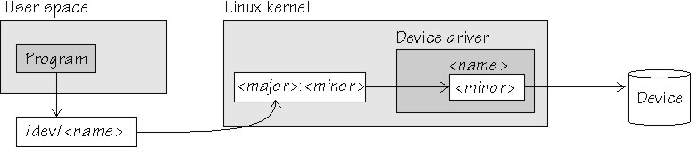
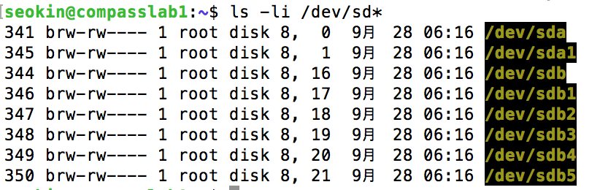
Properties of Device Files (I)
Device files have most of the properties disk files (regular file) have.
Major number and minor number
The inode of a device file stores, not a file size and storage list, but a pointer to a device driver in the kernel.
Device driver : a subroutine in the kernel that gets data into and out of a device
Major number specifies which device driver handles the device
Minor number specifies a particular instance of the device
file type
Major number, minor number
Notes:
c: this file is really a device that transfers data character by character.
A device file is a connection, not a container.
major # : specifies which subroutine handles the actual device, and the minor # is passed to that subroutine
The minor number identifies the unique physical device within that class. This is looked up in the /dev entry for the device.

Slide 11
Properties of Device Files (II)
Permission Bits
In the following example, what do permission bits mean when the file is really a device?
Writing permission means
→ owner of the device file and members of group tty are allowed to write to the terminal
Reading permission means
→only owner of the device file can read any terminal messages
Notes:
What do permission bits mean when the file is really a device?
Writing data into the file sends data to the device.
Writing characters to another person's terminal is the purpose of the Unix write command.
If users other than the owner of the file have permission to read, other people can read charracters typed at that keyboard; But it can cause trouble.
Reading key strokes from another person's terminal can cause trouble.

Slide 12
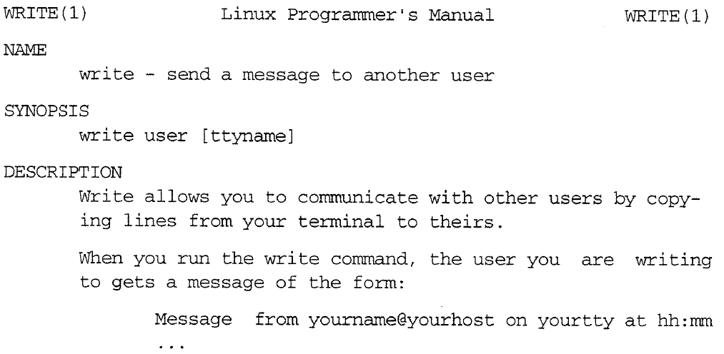
Ex1: Writing write (I)
$ write test /dev/pts/2
$ man 1 write

Slide 13
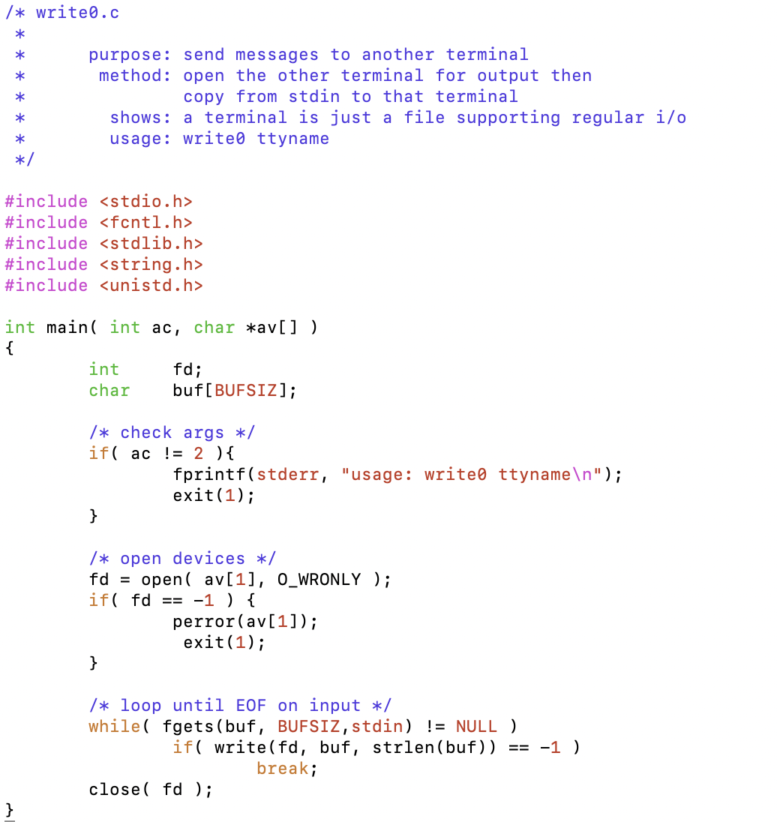
Ex1: Writing write (II)
$ cc write0.c –o write0
$ ./write0 /dev/pts/2
Is it working?...
Bye
^c
Notes:
It shows terminals can be treated like file

Slide 14
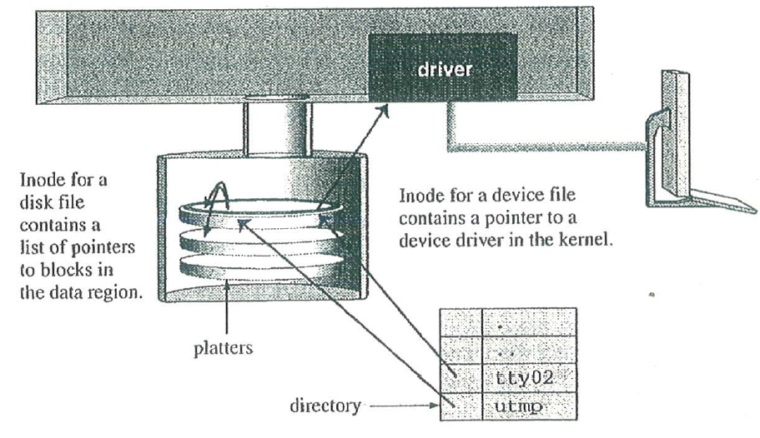
Device Files and Inodes (I)
The distinction between types of files appears at the inode level, not in a directory
inode can be a regular file inode or a device-file inode
A regular file inode contains a pointer to the data blocks
A device file inode contains a pointer into a table of kernel subroutines called device drivers
Device Driver

Slide 15
Device Files and Inodes (II)
How read() works?
Kernel finds the inode for the file descriptor.
inode tells the kernel the type of the file
If the file is a regular file,
the kernel gets data by consulting the block allocation list
If the file is a device file,
the kernel reads data by calling the read part of the device driver code for that device.
Notes:
Inode tells the kernel the type of the file.
each inode # pointers to a struct in inode table
inode can be a disk-file inode or device-file inode.
type of inode is recorded int the type prtion of the st_mode member of struc stat
major number tells where to find the code that gets data from the device

Slide 16
Contents
5.2 Devices Are Just Like Files
5.3 Devices Are Not Like files
5.4 Attributes of Disk Connections
5.5 Attributes of Terminal Connections
5.6 Programming Other Devices: ioctl
5.7 Up in the Sky!, It's a Device, It's a STREAM!

Slide 17
Devices Are Not Like Files
Connection to a regular file (disk file) is different from a connection to a terminal
Connection to a regular file usually involves kernel buffers.
Buffering is an attribute of the connection
Connection to terminal sends data to terminal pretty quickly
We can control attributes in a different way.
connection attributes

Slide 18
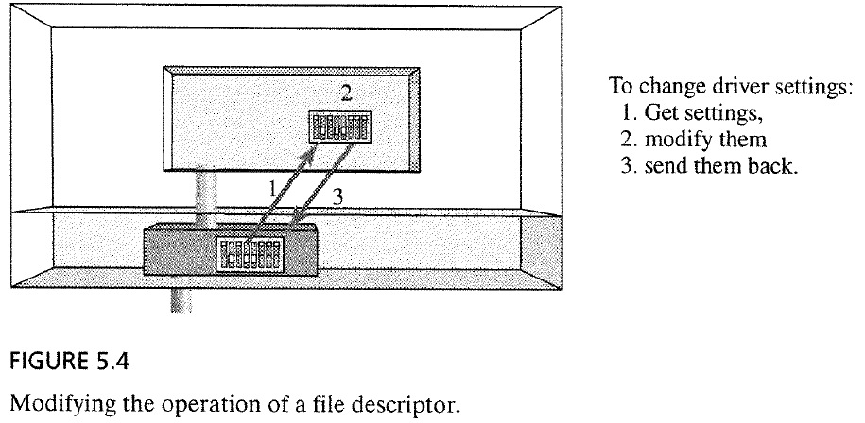
Controlling the connection attributes
You modify the device attributes by changing control variables of the file descriptor associated to the device.
Three steps
Get the current attributes
Modify them
Send them back
Notes:
O_SYNC bit
That bit tells the kernel that calls to write should return only when the bytes are written to the actual hardware
Setting O_SYNC eliminates all the efficiency kernel buffering provides.
You need a good reason to turn off buffering.

Slide 19
Controlling the connection attributes
System call: fcntl
fcntl
PURPOSE | Control file descriptors
INCLUDE | #include <fcntl.h> #include <unistd.h> #include <sys/types.h>
USAGE | int result = fcntl(int fd, int cmd); int result = fcntl(int fd, int cmd, long arg); int result = fcntl(int fd, int cmd, struct flock *lockp);
ARGS | fd cmd arg lock | the file descriptor to control the operation to perform arguments to the operation lock information
RETURNS | -1 Other | if error depends on operation
Notes:
Struct flock
{
short int l_type;
short int l_whence;
__off_t l_start;
__off_t l_len;
__pid_t l_pid;
};

Slide 20
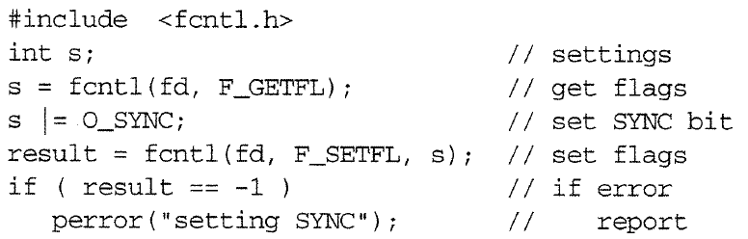
Controlling the attributes of disk connection (I)
Ex1: Turning off disk buffering
O_SYNC : tells the kernel that calls to write() should be return only when the bytes are written to the actual hardware
Notes:
Attributes of a fd are coded as bits in an integer.
fcntl() system call lets you control a fd by reading and writing that integer
O_SYNC bit
That bit tells the kernel that calls to write should return only when the bytes are written to the actual hardware
Setting O_SYNC eliminates all the efficiency kernel buffering provides.
You need a good reason to turn off buffering.

Slide 21
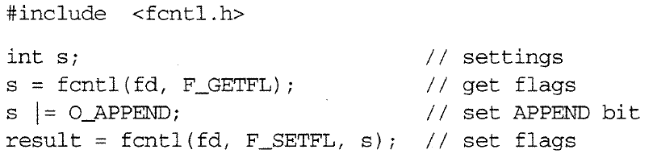
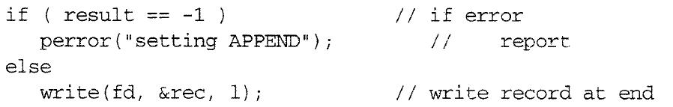
Controlling the attributes of disk connection (II)
Ex2: Turning on auto-append mode
With auto-append mode, each call to write() automatically includes an lseek to the end of file
Notes:
Attributes of a fd are coded as bits in an integer.
fcntl() system call lets you control a fd by reading and writing that integer
O_SYNC bit
That bit tells the kernel that calls to write should return only when the bytes are written to the actual hardware
Setting O_SYNC eliminates all the efficiency kernel buffering provides.
You need a good reason to turn off buffering.

Slide 22
Controlling the attributes with open
open() lets you specify fd attribute bits as part of its second argument
Notes:
Fcntl is not only way to set fd attributes
why does creat exist when open can do the job?
in the Olden days, open only opened files and create created new ones
later open was modified to support more flags, including the create option
O_EXCL : exclusive

Slide 23
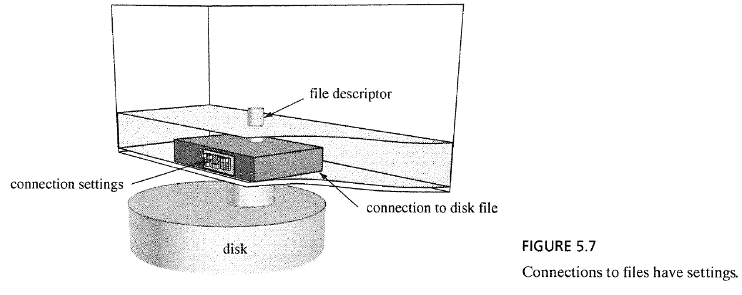
Summary of disk connections
The kernel transfers data between disks and processes
The code in the kernel that performs these transfers has many options
A program can use the open() and fcntl() system calls to control the attributes of these data transfers
Notes:
kernel transfers data between disks and processes : the code in kernel that performs these transfers has many options
a program can use open(), fcntl() to control the inner workings of these data transfers

Slide 24
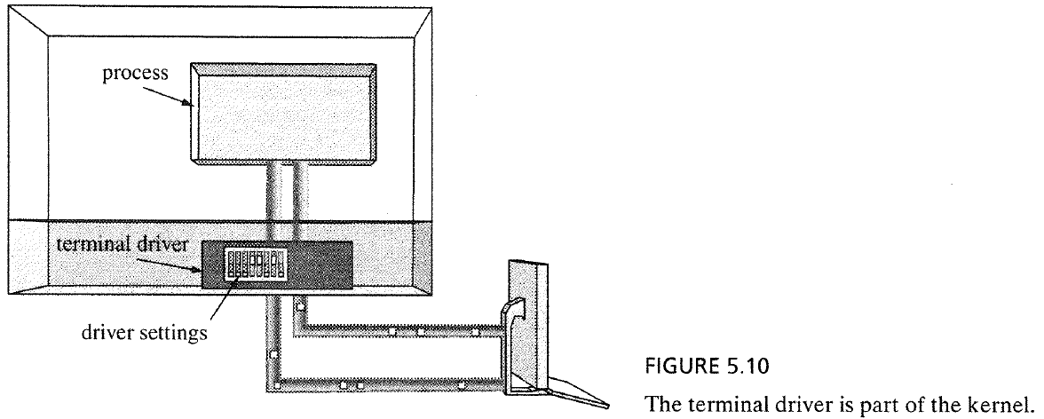
Terminal connection
Terminal Driver
The collection of kernel subroutines that process data flowing between a process and a terminal
The driver contains many settings that control its operation
A process may read, modify, and reset those driver control flags.
Notes:
A connection between a terminal and a process
Collection of kernel subroutines that process data flowing between a process and the external device
The driver contains many settings that control its operation;
A process may read, modify, and reset those driver control flags

Slide 25
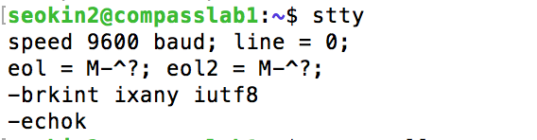
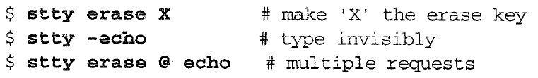
Controlling the attributes of terminal connection (I)
Using stty to Display Driver Settings
Using stty to Change Driver Settings
※ echo off
※ echo on
Notes:
stty lets users read and change settings in the driver for a terminal
icrnl - convert Carriage Return to NewLine
onlcr - Output: add to NewLine a Carriage Return
olcuc - Output: convert LowerCase to UpperCase
baud refers to how many times the voltage/signal level changes per second.

Slide 26
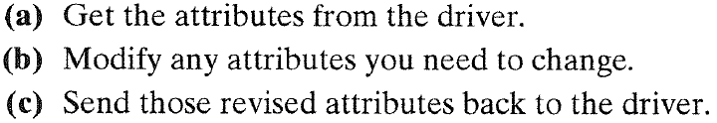
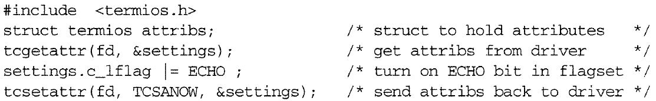
Controlling the attributes of terminal connection (II)
Changing setting in the terminal driver
Ex1: Turning on keystroke echoing
settings;
Notes:
tcgetattr( ), tcsetattr( ) provide access to the terminal driver
both transfer settings in a struct termios

Slide 27
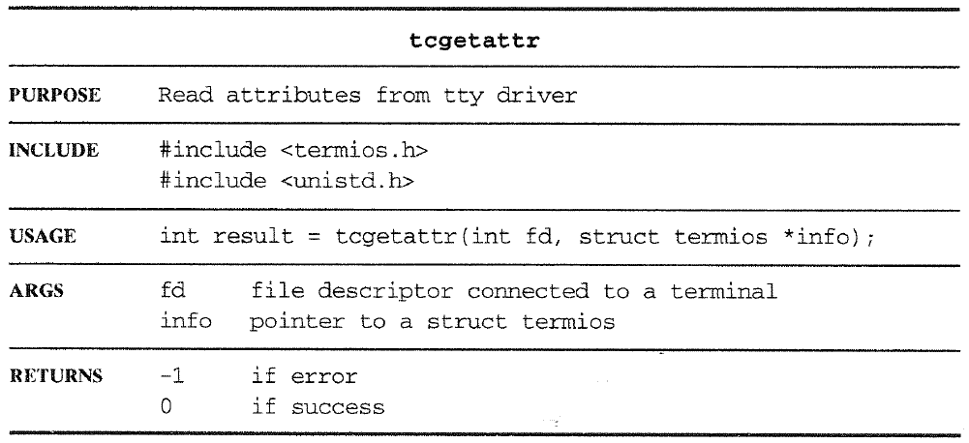
Turning on keystroke echoing (I)
tcgetattr() library function

Slide 28
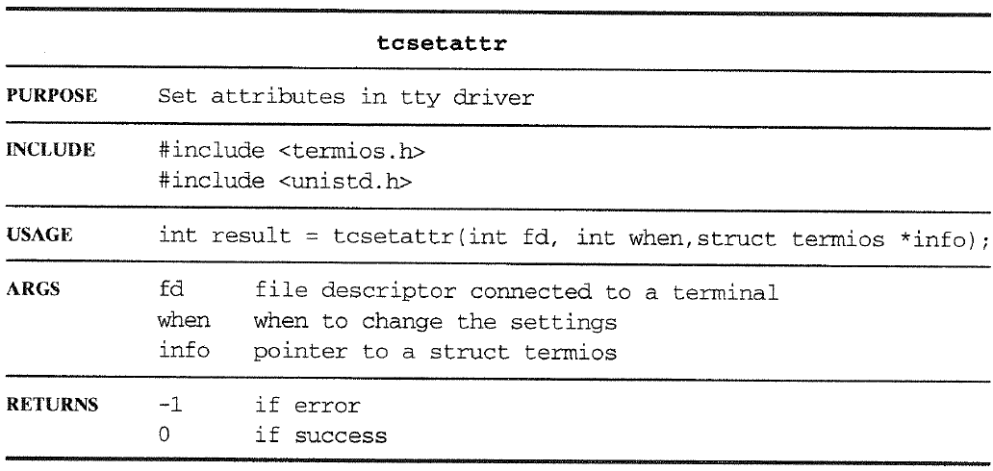
Turning on keystroke echoing (II)
tcsetattr() library function
TCSANOW : update driver setting immediately
TCSADRAIN : wait until all output already queued in the driver has been transmitted to the terminal
TCSAFLUSH : wait until all output already queued in the driver has been transmitted. Next, flush all queued input data
Notes:
TCSADRAIN
Wait until all output already queued in the driver has been transmitted to the terminal.
Then update the driver
TCSAFLUSH
Wait until all output already queued in the driver has been transmitted.
Next, flush all queued input data.
Then make the changes.

Slide 29
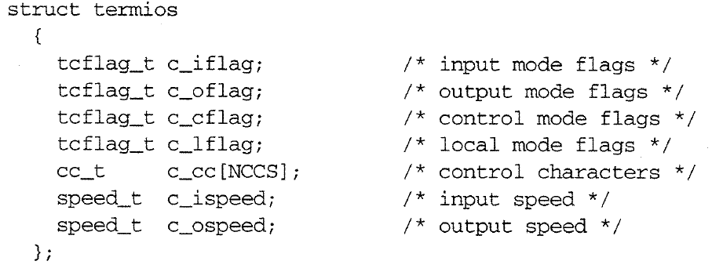
Turning on keystroke echoing (III)
The struct termios data type contains several flagsets and an array of control characters

Slide 30
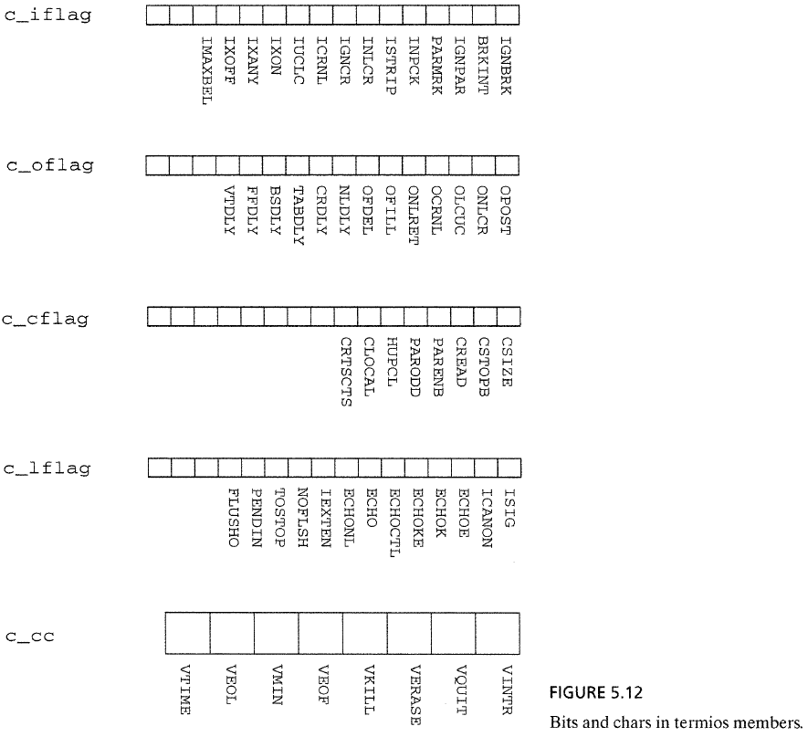
Turning on keystroke echoing (IV)
Bits and chars in struct termios members

Slide 31
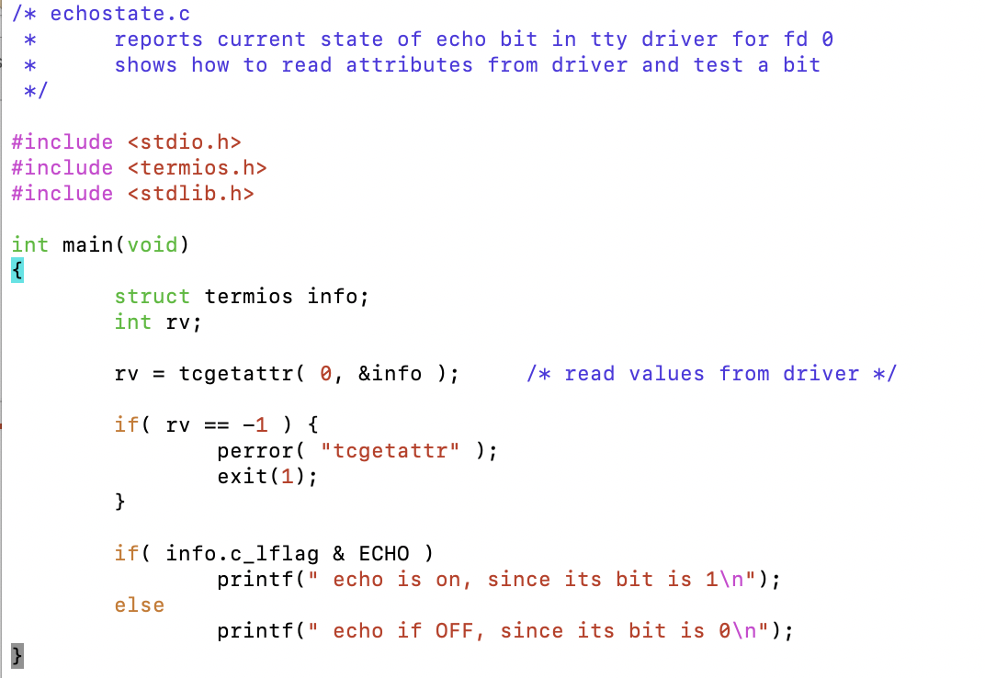
Ex2: Reporting the current state of the terminal (I)
//‘fd = 0’ indicates standard input which will be keyboard in the terminal
//Test a bit
Notes:
Example: echostate.c - show state of echo bit

Slide 32
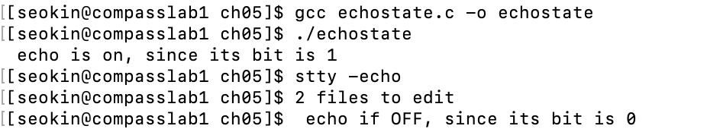
Ex2: Reporting the current state of the terminal (II)
Compile and test echostate.c
Notes:
Example: echostate.c - show state of echo bit

Slide 33
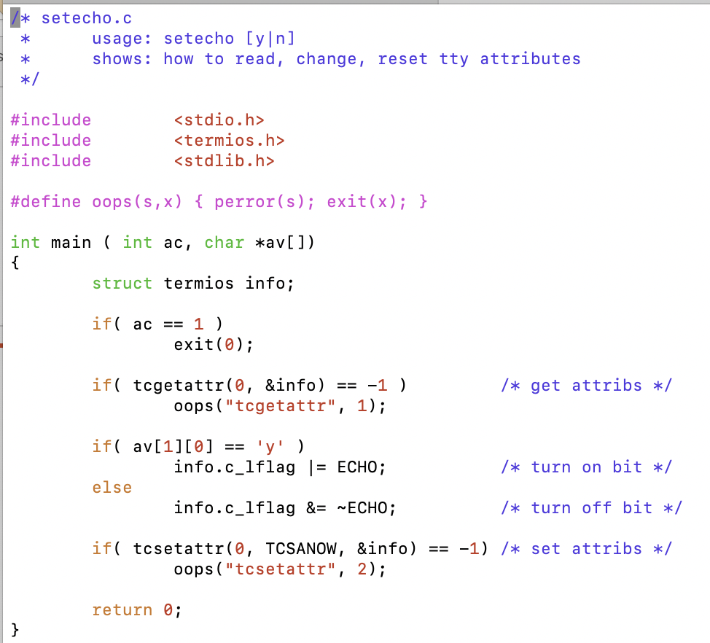
Ex3: Turning on/off echo mode (I)

Slide 34
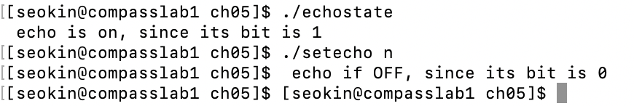
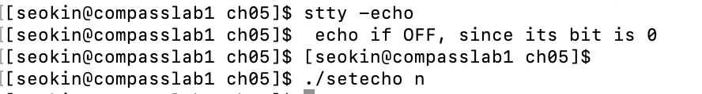
Ex3: Turning on/off echo mode (II)
Compile and test setecho.c
Notes:
Example: echostate.c - show state of echo bit

Slide 35
Contents
5.2 Devices Are Just Like Files
5.3 Devices Are Not Like files
5.4 Attributes of Disk Connections
5.5 Attributes of Terminal Connections
5.6 Programming Other Devices: ioctl

Slide 36
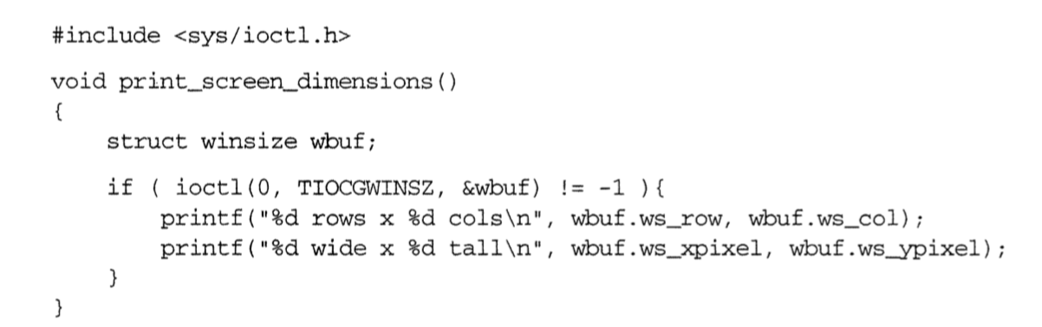
Programming Other Devices: ioctl
What about connections to other types of devices?
Ex) Scanners, Printers
Every device file supports the ioctl() system call
The ioctl() provides access to the attributes and operations of the device driver to fd.
Each type of device has its own set of properties and ioctl operations.
Ex) A video terminal screen has a size measured in rows and columns or in pixels
TIOCGWINGZ is the function code

Slide 37
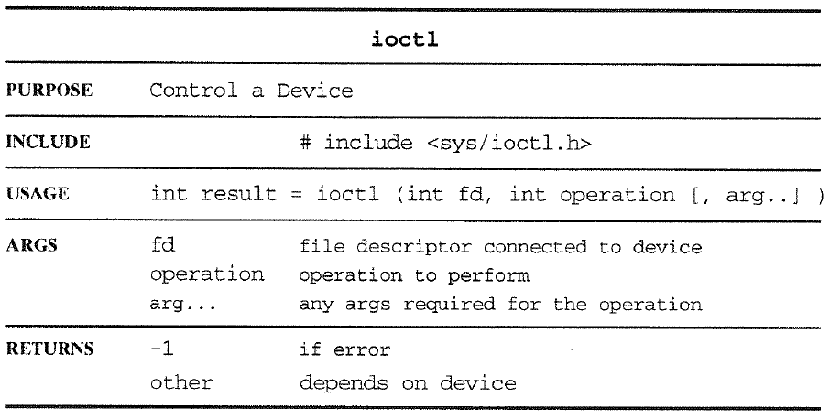
Programming Other Devices: ioctl

Slide 38
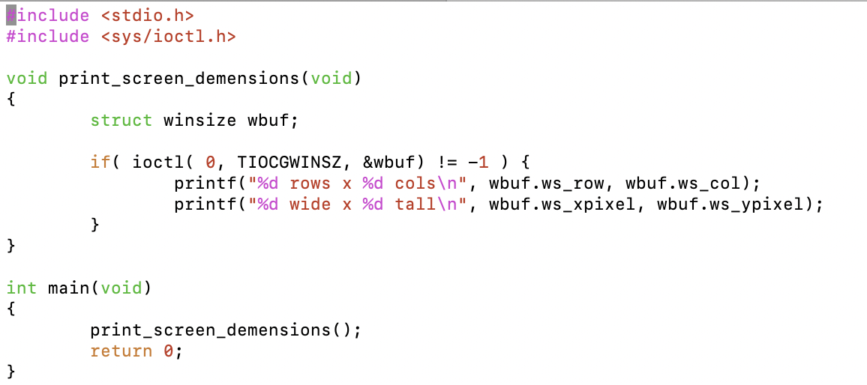
Ex4: Showscreen.c
TIOCGWINSZ :
Fill in winsize structure pointed to by the third argument with the screen width and height

